Slide 1
Visit:
https://www.teacherspayteachers.com/Store/Hippocampus-Store
For more resources.
Method 1: Paste your picture on a blank slide. Then ctrl+a to select all on one of the slides with the squares and ctrl+v to paste it over the pic. One click to start a second to reveal it all.
Method 2: Paste the picture you want over the squares on one of the slides. Right click on the picture and select the “send to back” option.

Slide 2
Visit:
https://www.teacherspayteachers.com/Store/Hippocampus-Store
For more resources.
Method 1: Paste your picture on a blank slide. Then ctrl+a to select all on one of the slides with the squares and ctrl+v to paste it over the pic. One click to start a second to reveal it all.
Method 2: Paste the picture you want over the squares on one of the slides. Right click on the picture and select the “send to back” option.

Slide 3
College Name Game

Slide 4
Can you name the college before the mascot is revealed?
Test your skills to see if can beat the clock!

Slide 5
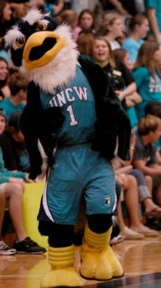

Slide 6
UNC Wilmington

Slide 8
Winston Salem State

Slide 10
Western Carolina University

Slide 12
UNC Greensboro

Slide 14
UNC Asheville

Slide 16
NC State University

Slide 18
NC Central University

Slide 19
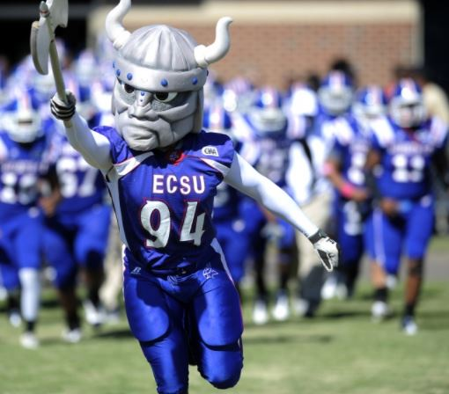

Slide 20
Elizabeth City State University

Slide 22
UNC Pembroke

Slide 24
UNC Chapel Hill

Slide 26
Appalachian State University

Slide 27
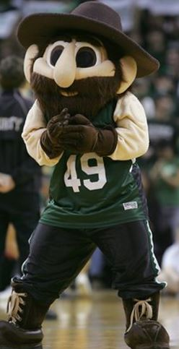

Slide 28
UNC Charlotte

Slide 29
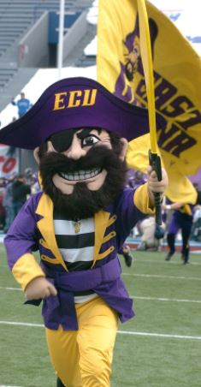

Slide 30
East Carolina University

Slide 31
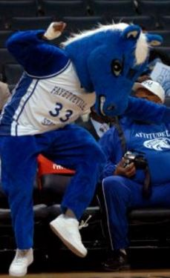

Slide 32
Fayetteville State University

Slide 33
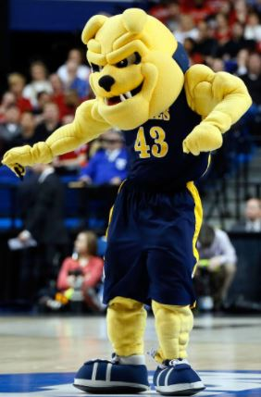

Slide 34
NC A&T University

Slide 36
Thank you for playing!
GEAR UP
Wilkes County Schools!

