Slide 1
Visit:
https://www.teacherspayteachers.com/Store/Hippocampus-Store
For more resources.
Method 1: Paste your picture on a blank slide. Then ctrl+a to select all on one of the slides with the squares and ctrl+v to paste it over the pic. One click to start a second to reveal it all.
Method 2: Paste the picture you want over the squares on one of the slides. Right click on the picture and select the “send to back” option.

Slide 2
Visit:
https://www.teacherspayteachers.com/Store/Hippocampus-Store
For more resources.
Method 1: Paste your picture on a blank slide. Then ctrl+a to select all on one of the slides with the squares and ctrl+v to paste it over the pic. One click to start a second to reveal it all.
Method 2: Paste the picture you want over the squares on one of the slides. Right click on the picture and select the “send to back” option.

Slide 3
Name that College

Slide 4
Can you name the college before the answer is revealed?
Test your skills to see if can beat the clock!

Slide 5
What college has the distinction of being the oldest public university in United States?

Slide 7
What college in North Carolina was founded in 1899 as a teacher’s college by BB and DD Dougherty? Hint: The two brother’s have buildings on the campus that still bear the founders names.

Slide 8
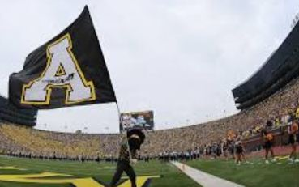

Slide 9
Which colleges have graduated the most U. S. Presidents?

Slide 10
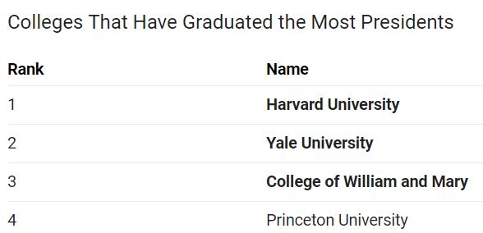

Slide 11
Which NC college was founded in 1887 as the NC College of Agriculture and Mechanical Arts

Slide 13
Which university has produced the most current NFL, MLB, and NBA players?

Slide 15
What community college is in Winston Salem, NC?

Slide 16
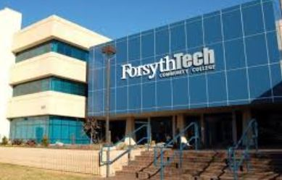

Slide 17
What is the Wilkes Community College Mascot?

Slide 19
Which NC University gives each student a sapling (tree) to commemorate their future growth?

Slide 21
Which NC University participates in a Krispy Kreme Challenge which includes a 5K run to and from the Krispy Kreme store, where each participants down a dozen donuts?

Slide 23
What is the largest community college in NC by enrollment?

Slide 25
Thank you for playing!
GEAR UP
Wilkes County Schools!

